Slide 1
Predicting Call Trends and Customer Churn Using Weather Data
An Analysis of Telecom Churn and Weather Patterns in the United States Using K-Nearest Neighbors (KNN) Presented By: Donn Bryan Julian

Slide 2
Agenda
Data Sources
ETL Process
Exploratory Data Analysis (EDA)
Modeling
Model Results (KNN)
Key Findings
Recommendations
Next Steps

Slide 3
Data Sources
Telecom Churn Dataset:
Source: Telecom Churn Clean Dataset on Kaggle
Description: Contains customer data, churn status, area codes, call usage details.
Weather Dataset:
Source: Global Weather Repository on Kaggle
Description: Historical weather data by country and region (temperature, precipitation, humidity).

Slide 4
ETL Process
Extract:
Pulled the telecom churn dataset and weather dataset from Kaggle.
Focused on California area codes for granular analysis.
Transform:
Cleaned and filtered both datasets.
Merged weather data with telecom data using area codes.
Removed irrelevant columns (e.g., non-U.S. data).
Load:
Combined dataset used for training and evaluation in modeling phase.

Slide 5
Exploratory Data Analysis (EDA)
Objective of EDA:
Explore the relationship between weather data and customer churn.
Identify the key features influencing telecom service usage and churn.
Insights Derived:
Customer Service Calls:
There's a noticeable correlation between customer service calls and churn (0.21).
Weather-Related Features:
Variables like temperature (0.02) and precipitation show minor correlations with churn, indicating more subtle patterns, likely better captured by non-linear models like KNN.
Key Visualizations:
Correlation Heatmap:
The matrix highlights relationships between key features such as call behavior, weather patterns, and churn.
Strong correlations between telecom usage metrics (e.g., day minutes and day charges), while churn is moderately correlated with customer service calls.
Place the correlation matrix image here (Resize it if needed to fit well within the slide layout).
Feature Selection:
The EDA led to the selection of:
Key Telecom Features: Customer service calls, total day minutes, and charges.
Weather Features: Temperature, precipitation, wind speed, and humidity.

Slide 6
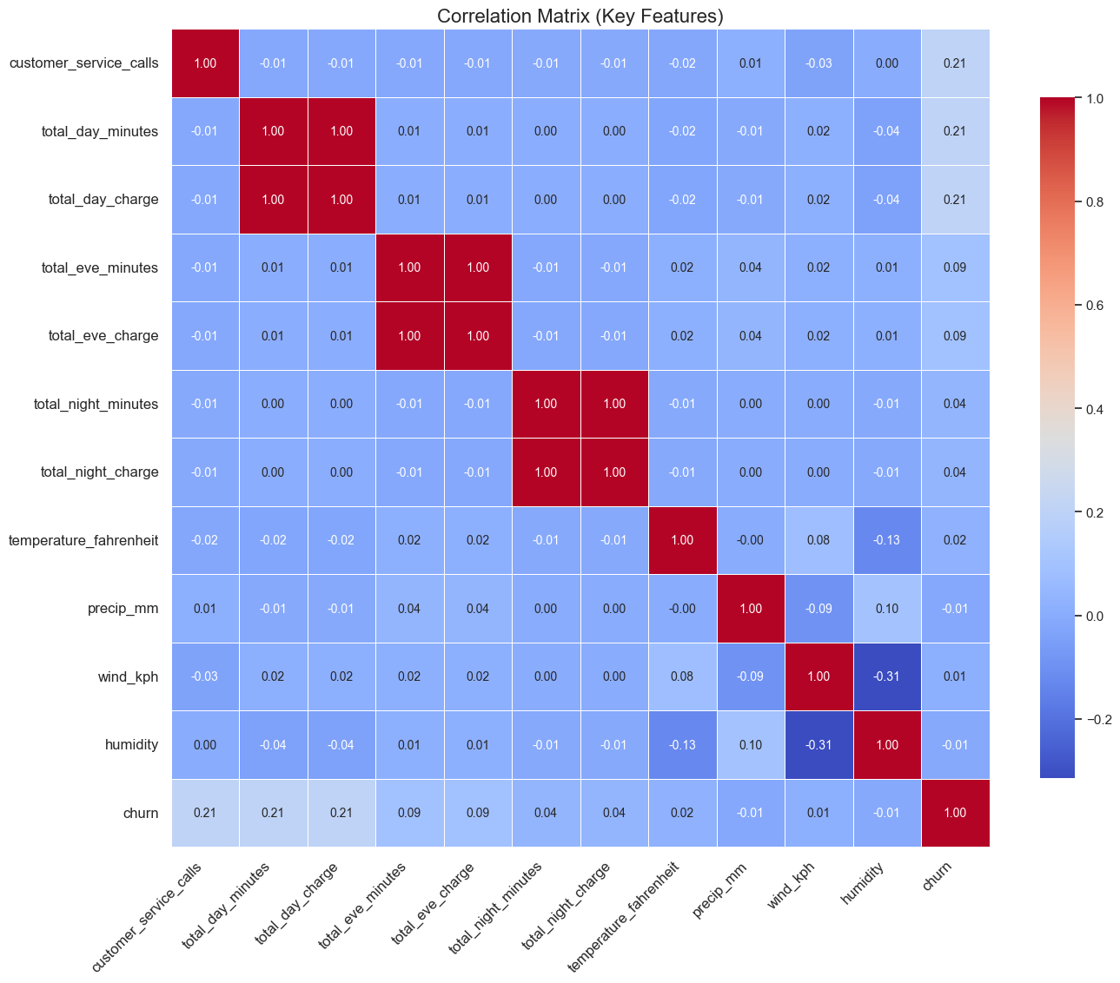
Customer service calls and telecom usage metrics show moderate correlations with churn. Weather variables have weaker linear correlations, suggesting possible non-linear relationships that models like KNN can capture.

Slide 7
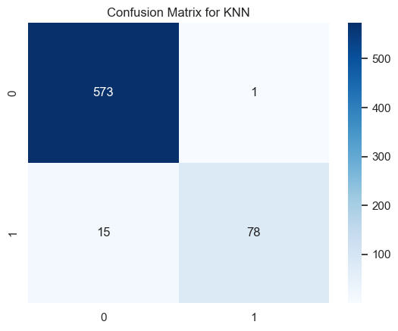
Modeling Process (KNN)
Brief Description:
For this analysis, we selected K-Nearest Neighbors (KNN) to capture potential non-linear relationships between weather conditions and churn.
The confusion matrix shows that the model achieved high accuracy in predicting both churned and non-churned customers, with only a small number of misclassifications.
True Positives (1,1): 78 correctly predicted churns.
True Negatives (0,0): 573 correctly predicted non-churns.
Only 16 misclassifications (1 false positive and 15 false negatives). Classification Report (Text or a simple table):
Accuracy: 98%
Precision for class 0 (Non-Churn): 0.97, class 1 (Churn): 0.99
Recall for class 0: 1.00, class 1: 0.84
F1-score: 0.99 for class 0, 0.91 for class 1

Slide 8
Key Findings
Churn is correlated with customer service calls:
The model confirms that frequent customer service interactions are a strong predictor of churn.
Customers who made multiple service calls were more likely to churn.
Telecom Usage Metrics impact churn:
High usage during the day (total day minutes and charges) has a moderate correlation with churn, likely due to bill shock or service dissatisfaction.
Weather conditions have weak linear correlations:
Weather features like temperature and precipitation showed weak direct correlations with churn, but the KNN model helped reveal non-linear relationships.
KNN Model Performance:
The model achieved a high 98% accuracy with strong precision and recall for both churned and non-churned customers.
The model performed well at predicting churn, with a 0.99 precision for churned customers and an F1-score of 0.91.

Slide 9
Recommendations
Recommendations:
Proactive Customer Support for High-Risk Users:
Increase customer support resources for customers making frequent service calls, as they are more likely to churn.
Implement targeted retention strategies for customers identified as high-risk by the model (e.g., those with high usage and frequent service calls).
Weather-Based Campaigns:
Use weather data to anticipate service issues or potential dissatisfaction in areas experiencing extreme weather conditions.
Offer incentives or discounts to customers in regions affected by severe weather to reduce churn.
Refine Telecom Packages Based on Usage:
Analyze high usage patterns (e.g., total day minutes and charges) to optimize telecom packages, avoiding bill shock that could drive churn.
Consider creating customized plans for heavy users to enhance customer satisfaction and retention.
Deploy KNN Model for Real-Time Churn Prediction:
Integrate the KNN model into your systems for real-time monitoring of churn risk.
Use the model’s insights to predict churn and adjust customer service efforts dynamically.

Slide 10
Next Steps
Deploy the KNN Model:
Integrate the trained KNN model into the telecom’s existing systems for real-time churn prediction.
Ensure that customer service teams and marketing departments have access to these predictions for proactive outreach.
Monitor and Optimize Model Performance:
Set up regular performance reviews for the model to ensure it maintains high accuracy as new data is introduced.
Continuously retrain the model with fresh data to capture evolving customer behavior and changing weather patterns.
Expand the Model:
Extend the current model beyond California to other regions, incorporating more geographic data to predict churn across the country.
Add other external factors (e.g., economic data, service outages) to improve prediction accuracy and cover more scenarios.
Improve Customer Experience Based on Insights:
Use the churn predictions to optimize customer service workflows, increasing support in high-risk areas during severe weather events.
Personalize marketing campaigns based on usage patterns and churn risk levels to increase retention.

Slide 11
Q&A
Thank you for your attention.
We’re happy to take any questions you may have

